Slide 1
Randomized Algorithms CS648
Lecture 24
Practice Problems

Slide 2
3 Practice Problems

Slide 3
3-SAT Problem

Slide 4
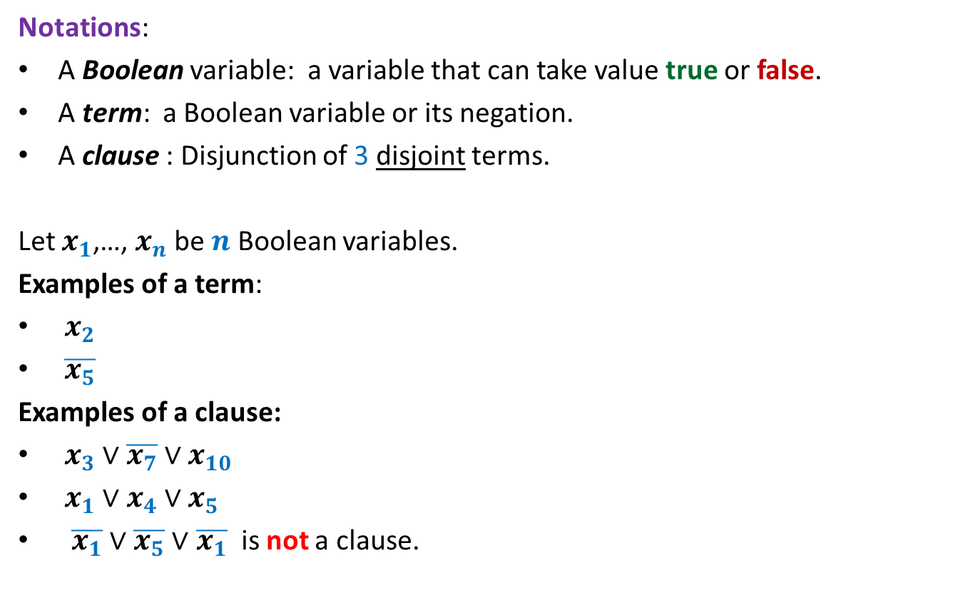
3-SAT Problem
Notations:
A Boolean variable: a variable that can take value true or false.
A term: a Boolean variable or its negation.
A clause : Disjunction of 3 disjoint terms.
Let $x_{1}$,…, $x_{n}$ be $n$ Boolean variables.
Examples of a term:
$x_{2}$
$\overline{x_{5}}$
Examples of a clause:
$x_{3}∨\overline{x_{7}}∨x_{10}$
$x_{1}∨x_{4}∨x_{5}$
$\overline{x_{1}}∨$ $\overline{x_{5}}∨$ $\overline{x_{1}}$ is not a clause.

Slide 5
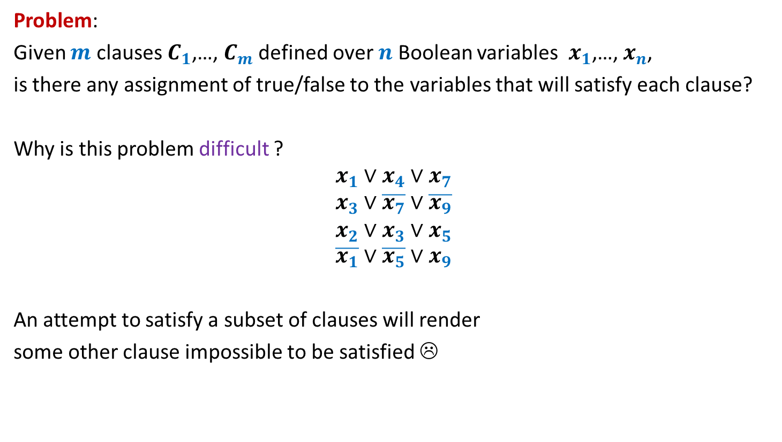
3-SAT Problem
Problem:
Given $m$ clauses $C_{1}$,…, $C_{m}$ defined over $n$ Boolean variables $x_{1}$,…, $x_{n}$,
is there any assignment of true/false to the variables that will satisfy each clause?
Why is this problem difficult ?
$$x_{1}∨x_{4}∨x_{7}$$
$$x_{3}∨\overline{x_{7}}∨\overline{x_{9}}$$
$$x_{2}∨x_{3}∨x_{5}$$
$$\overline{x_{1}}∨\overline{x_{5}}∨x_{9}$$
An attempt to satisfy a subset of clauses will render
some other clause impossible to be satisfied ☹

Slide 6
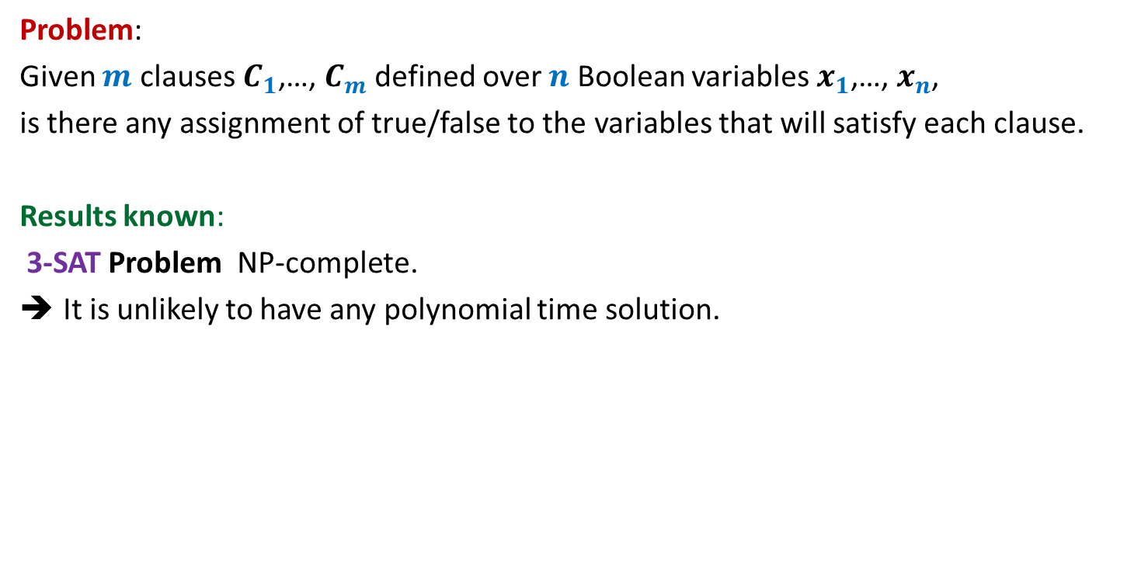
3-SAT Problem
Problem:
Given $m$ clauses $C_{1}$,…, $C_{m}$ defined over $n$ Boolean variables $x_{1}$,…, $x_{n}$,
is there any assignment of true/false to the variables that will satisfy each clause.
Results known:
3-SAT Problem NP-complete.
It is unlikely to have any polynomial time solution.

Slide 7
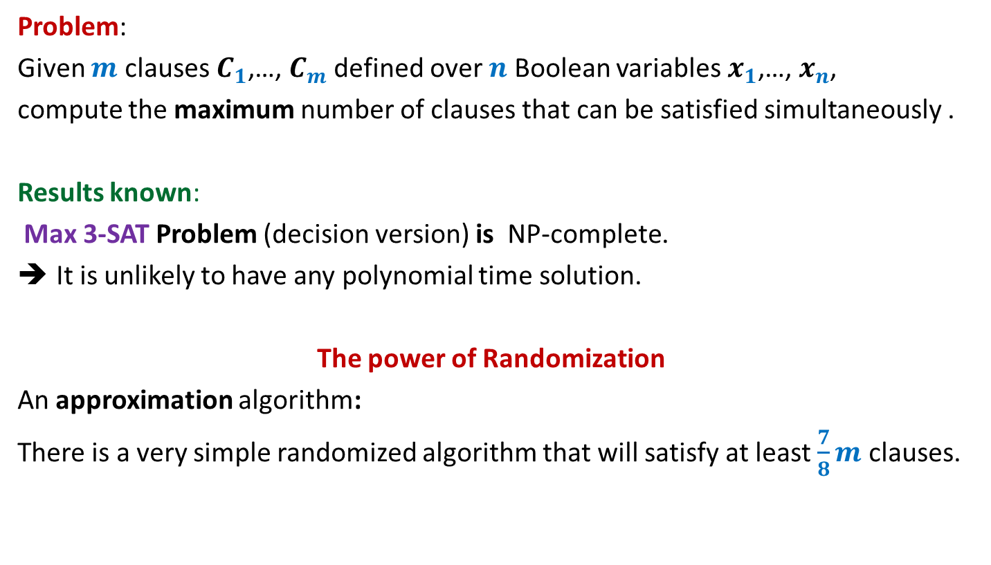
Max 3-SAT Problem
Problem:
Given $m$ clauses $C_{1}$,…, $C_{m}$ defined over $n$ Boolean variables $x_{1}$,…, $x_{n}$,
compute the maximum number of clauses that can be satisfied simultaneously .
Results known:
Max 3-SAT Problem (decision version) is NP-complete.
It is unlikely to have any polynomial time solution.
The power of Randomization
An approximation algorithm:
There is a very simple randomized algorithm that will satisfy at least $\frac{7}{8}m$ clauses.

Slide 8



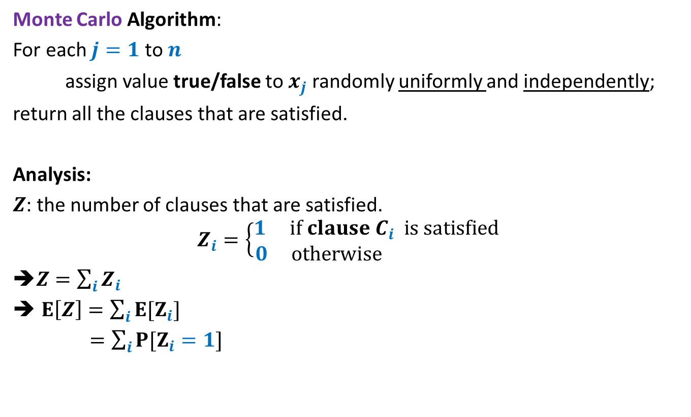
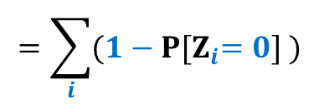





Max 3-SAT Problem
Monte Carlo Algorithm:
For each $j=1$ to $n$
assign value true/false to $x_{j}$ randomly uniformly and independently;
return all the clauses that are satisfied.
Analysis:
$Z$: the number of clauses that are satisfied.
$$Z_{i}=\left\{\begin{aligned}1 if clause C_{i} is satisfied \\ 0 otherwise \end{aligned}\right.$$
➔$Z=\sum_{i}{Z_{i}}$
$E\left[Z\right]=\sum_{i}{{E[Z}_{i}]}$
$=\sum_{i}{{P[Z}_{i}=1]}$
$$\frac{1}{2}$$
$$×$$
$$\frac{1}{2}$$
$$×$$
$$\frac{1}{2}$$
$$=\sum_{i}{{(1−P[Z}_{i}=0] )}$$
$$=\sum_{i}{\frac{7}{8}}$$
$$=\frac{7}{8}m$$
$$\overline{x_{1}}∨\overline{x_{5}}∨x_{9}$$
$\frac{1}{8}$

Slide 9
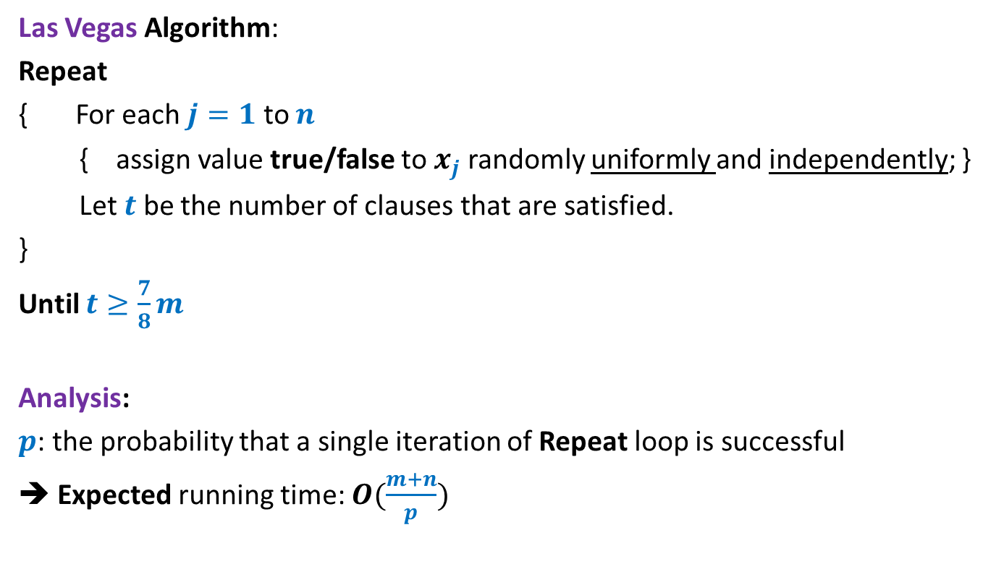
Max 3-SAT Problem
Las Vegas Algorithm:
Repeat
{ For each $j=1$ to $n$
{ assign value true/false to $x_{j}$ randomly uniformly and independently; }
Let $t$ be the number of clauses that are satisfied.
}
Until $t≥\frac{7}{8}m$
Analysis:
$p$: the probability that a single iteration of Repeat loop is successful
➔ Expected running time: $O(\frac{m+n}{p})$

Slide 10
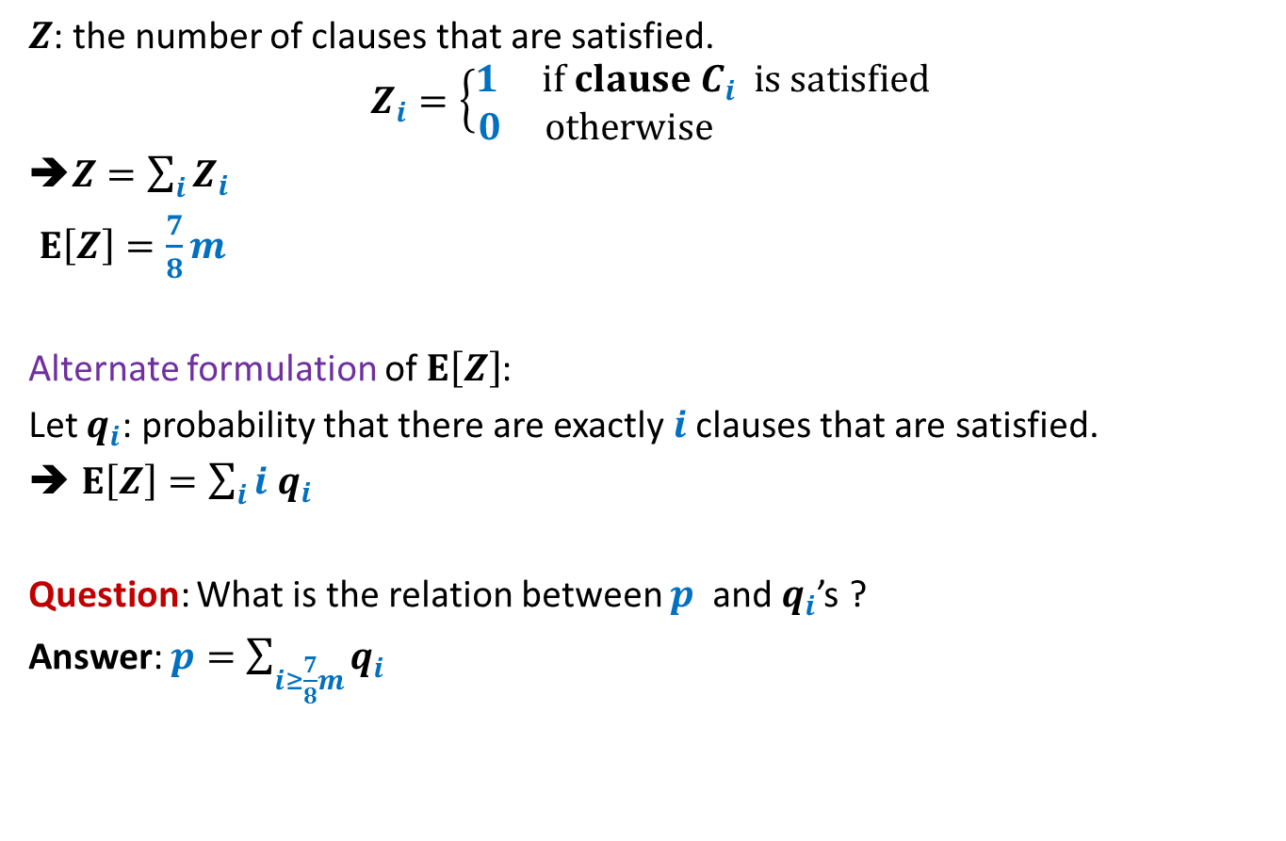

Getting a lower bound on $p$
$Z$: the number of clauses that are satisfied.
$$Z_{i}=\left\{\begin{aligned}1 if clause C_{i} is satisfied \\ 0 otherwise \end{aligned}\right.$$
➔$Z=\sum_{i}{Z_{i}}$
$E\left[Z\right]=\frac{7}{8}m$
Alternate formulation of $E\left[Z\right]$:
Let $q_{i}$: probability that there are exactly $i$clauses that are satisfied.
$E\left[Z\right]=\sum_{i}{i q_{i}}$
Question: What is the relation between $p$ and $q_{i}$’s ?
Answer: $p=\sum_{i≥\frac{7}{8}m}{q_{i}}$

Slide 11





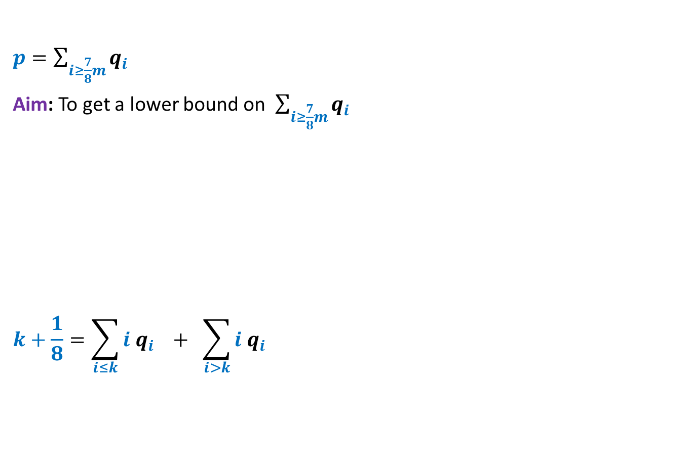




Getting a lower bound on $p$
$p=\sum_{i≥\frac{7}{8}m}{q_{i}}$
Aim: To get a lower bound on $\sum_{i≥\frac{7}{8}m}{q_{i}}$
$$k+\frac{1}{8}=\sum_{i≤k}{i q_{i}} + \sum_{i>k}{i q_{i}}$$
$$\sum_{i<\frac{7}{8}m}{q_{i}}$$
$$\sum_{i≥\frac{7}{8}m}{q_{i}}$$
+
$$0$$
$$1$$
$$2$$
$$k$$
$$m$$
$$\frac{7}{8}m$$

Slide 12






Getting a lower bound on $p$
$p=\sum_{i≥\frac{7}{8}m}{q_{i}}$
Aim: To get a lower bound on $\sum_{i≥\frac{7}{8}m}{q_{i}}$
$$k+\frac{1}{8}=\sum_{i≤k}{i q_{i}} + \sum_{i>k}{i q_{i}}$$
$$\sum_{i<\frac{7}{8}m}{q_{i}}$$
$$\sum_{i≥\frac{7}{8}m}{q_{i}}$$
+
$$i≤k$$
$$\frac{1}{8}$$
$$i>k$$
$$0$$
$$1$$
$$2$$
$$k$$
$$m$$
$$\frac{7}{8}m$$
+
$$m\sum_{i>k}{q_{i}}$$
$$p≥\frac{1}{8m}$$
$$≤k$$

Slide 13

Homework
Generalize the analysis given in the previous slide that covers all cases for
$\frac{7}{8}m$, including the case when it is an integer. The solution is given on the following page. Watch it only after trying hard on your own …

Slide 14

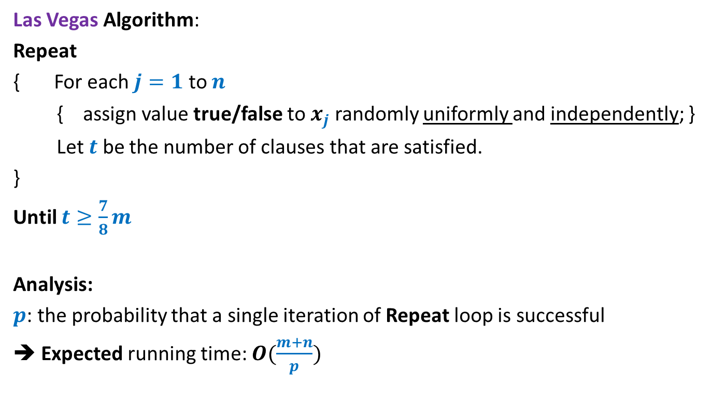
Max 3-SAT Problem
Las Vegas Algorithm:
Repeat
{ For each $j=1$ to $n$
{ assign value true/false to $x_{j}$ randomly uniformly and independently; }
Let $t$ be the number of clauses that are satisfied.
}
Until $t≥\frac{7}{8}m$
Analysis:
$p$: the probability that a single iteration of Repeat loop is successful
➔ Expected running time: $O(\frac{m+n}{p})$
$$=O({\left(m+n\right)}^{2})$$

Slide 15
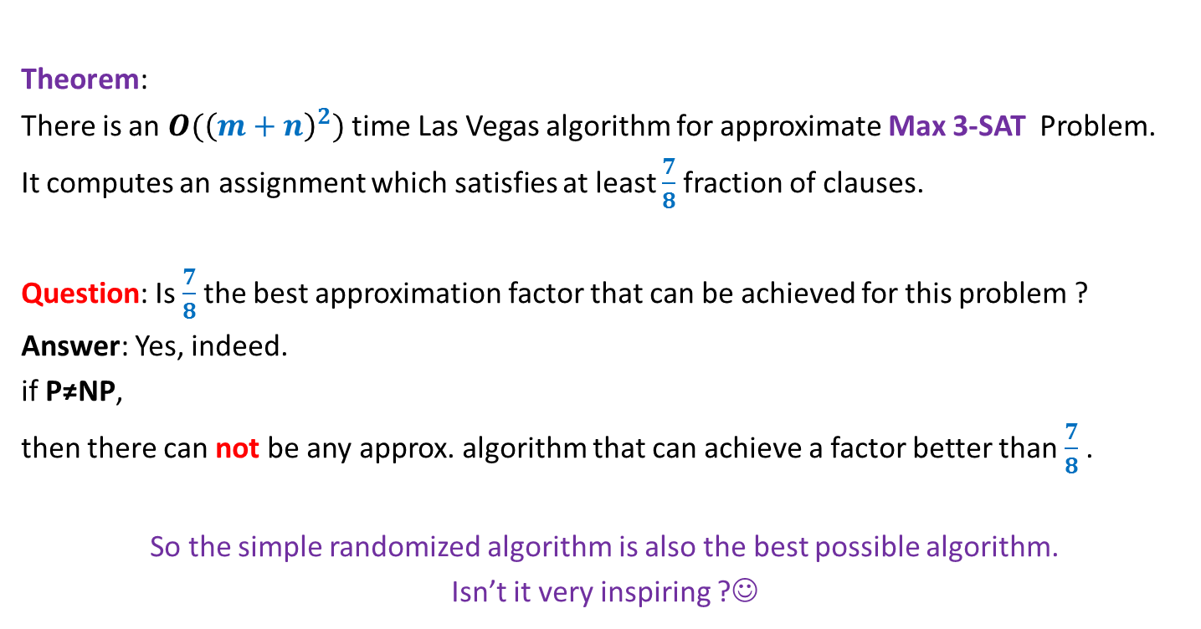
Max 3-SAT Problem
Theorem:
There is an $O({\left(m+n\right)}^{2})$ time Las Vegas algorithm for approximate Max 3-SAT Problem.
It computes an assignment which satisfies at least $\frac{7}{8}$fraction of clauses.
Question: Is $\frac{7}{8}$the best approximation factor that can be achieved for this problem ?
Answer: Yes, indeed.
if P≠NP,
then there can not be any approx. algorithm that can achieve a factor better than $\frac{7}{8}$ .
So the simple randomized algorithm is also the best possible algorithm.
Isn’t it very inspiring ?☺

Slide 16
Restoring distance matrix

Slide 17

Restoring distance matrix
$G$is an undirected unweighted graph.
$D$ is a matrix storing all-pairs distances of $G$.
Unfortunately, all entries with value larger than $\frac{n}{10}$ are corrupted.
Aim: Monte-Carlo algorithm with running time $O(n^{2} log n)$.

Slide 18

Restoring distance matrix
Dist(w,u)+Dist(w,v)=Dist(u,v)
BFS tree rooted at a w stores distance between u and v.
Hints:
1. Sample c log n vertices.
2. Build BFS tree on each of them.
3. Use these trees to restore distance matrix.
Analysis: Union Theorem.
$$≥\frac{n}{10}$$
u
w
v
Complete the solution as a Homework

Slide 19
Approximate Ham-sandwich cut

Slide 20
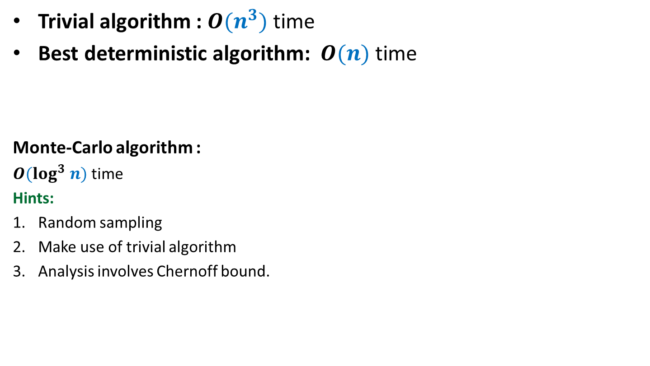
Ham-sandwich cut
¼-approximate
Trivial algorithm : $O(n^{3})$ time
Best deterministic algorithm: $O(n)$ time
Monte-Carlo algorithm :
$O(log^{3} n)$ time
Hints:
Random sampling
Make use of trivial algorithm
Analysis involves Chernoff bound.
Complete the solution as a Homework

